Slide 1
to Heritage Country Church

Slide 2
Take Your Bible From The Shelf
Take your Bible from the shelf
Dust it off, do it yourself
Open up and look inside
Set aside your foolish pride

Slide 3
Everything you’ll ever need
Was given up on Calvary
God is the light the very one
He gave us His only Son

Slide 4
You are His daughter and His sons
He doesn’t judge for what you’ve done
Don’t let the devil have control
Let God’s spirit fill your soul

Slide 5
He’ll take your sorrow and your pain
When you give thanks praise His name
With every day His blessings come
Glorify the Father and the Son

Slide 6
Take your bible from the shelf
Take it down, read it well
Don’t forget to take the time
Read to your kids, all the time

Slide 7
Tell them all about the life
Of our savior Jesus Christ
How wonderful He is
He saved us from a world of sin

Slide 8
You are His daughter and His sons
He doesn’t judge for what you’ve done
Don’t let the devil have control
Let God’s spirit fill your soul

Slide 9
He’ll take your sorrow and your pain
When you give thanks praise His name
With every day His blessings come

Slide 10
Glorify the Father and the Son
With every day His blessings come
Glory to the Father and the Son

Slide 11
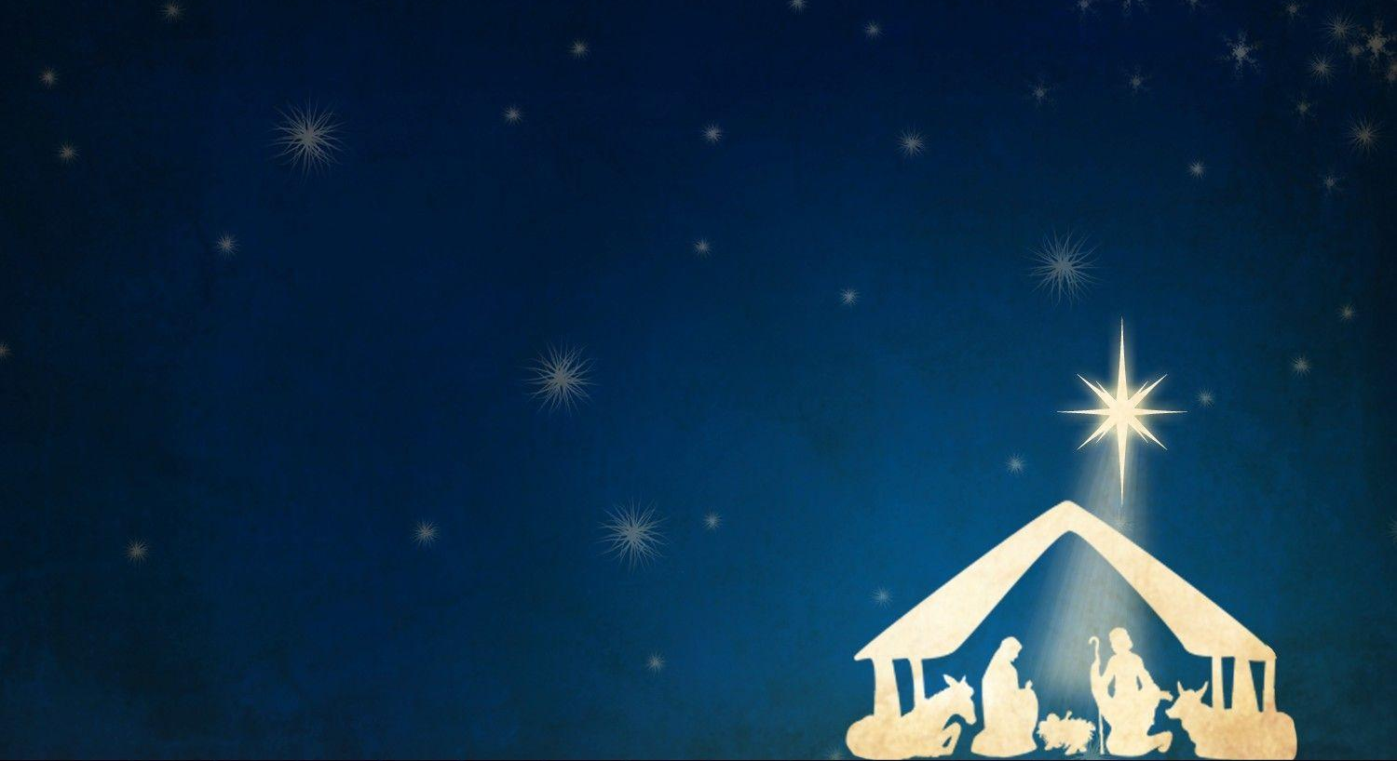
Welcome to
Heritage Country Church
Welcome to
Heritage Country Church

Slide 12
How Great Thou Art
O’ Lord my God,
When I in awesome wonder
Consider all the works
Thy hands have made

Slide 13
I see the stars,
I hear the rolling thunder
Thy power throughout
The universe displayed

Slide 14
Then sings my soul,
My Savior God to Thee
How great Thou art,
How great Thou art

Slide 15
Then sings my soul,
My Savior God to Thee
How great Thou art,
How great Thou art

Slide 16
When Christ shall come,
With shout of acclamation
And take me home,
What joy shall fill my heart

Slide 17
Then I shall bow,
In humble adoration
And then proclaim
My God how great Thou art

Slide 18
Then sings my soul,
My Savior God to Thee
How great Thou art,
How great Thou art

Slide 19
Then sings my soul,
My Savior God to Thee
How great Thou art,
How great Thou art
How great Thou art,
How great Thou art

Slide 20
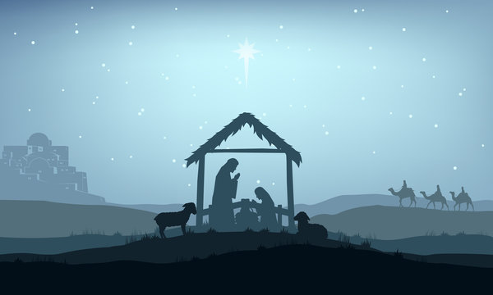
Welcome to
Heritage Country Church
Welcome to
Heritage Country Church

Slide 21
Oh, Holy Night
O holy night!
The stars are brightly shining It is the night
Of the dear Savior’s birth

Slide 22
Long lay the world
In sin and error pining Till He appeared
And the soul felt its worth

Slide 23
A thrill of hope
The weary world rejoices For yonder breaks
A new and glorious morn!

Slide 24
Fall on your knees!
O hear the angel voices! O night divine,
O night when Christ was born! O night, O holy night, O night divine!

Slide 25
Led by the light
Of faith serenely beaming With glowing hearts
By His cradle we stand

Slide 26
The King of kings
Lay thus in lowly manger In all our trials
Born to be our Friend

Slide 27
He knows our need
To our weakness is no stranger Behold your King
Before Him lowly bend! Behold your King
Before Him lowly bend!

Slide 28
Truly He taught us
To love one another; His law is love
And His gospel is peace

Slide 29
Chains shall he break,
For the slave is our brother And in his name
All oppression shall cease

Slide 30
Sweet hymns of joy
In grateful chorus raise we Let all within us
Praise His holy name

Slide 31
Christ is the Lord!
O praise His name forever! His pow’r and glory
Evermore proclaim! His pow’r and glory
Evermore proclaim!

Slide 32
UPCOMING DATES
1/14: Leadership Meeting after the service
1/25-27: CTYRA Rodeo
1/28 Potluck after the service
2/11: Leadership Meeting after the service
2/22-24: CTYRA Rodeo
2/25: Potluck after the service
3/1-2: Church Rodeo
3/16: CTBRA Barrel Racing
3/23: Church Fundraiser @ Tenroc Ranch

Slide 36
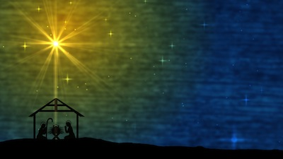
Welcome to
Heritage Country Church

Slide 37
Graves Into Gardens
I searched the world
But it couldn't fill me
Man's empty praise
And treasures that fade
Were never enough

Slide 38
Then You came along
And put me back together
And every desire is now satisfied
Here in Your love

Slide 39
Oh, there's nothing better than You
There's nothing better than You
Lord there's nothing
Nothing is better than You

Slide 40
I'm not afraid
To show You my weakness
My failures and flaws
Lord You've seen them all
And You still call me friend

Slide 41
'Cause the God of the mountain
Is the God of the valley
There's not a place
Your mercy and grace
Won't find me again

Slide 42
Oh, there's nothing better than You
There's nothing better than You
Lord there's nothing
Nothing is better than You

Slide 43
You turn mourning to dancing
You give beauty for ashes
You turn shame into glory
You're the only one who can

Slide 44
You turn graves into gardens
You turn bones into armies
You turn seas into highways
You're the only one who can
You're the only one who can

Slide 45
Oh, there's nothing better than You
There's nothing better than You
Lord there's nothing
Nothing is better than You

Slide 46
Oh, there's nothing better than You
There's nothing better than You
Lord there's nothing
Nothing is better than You

Slide 47
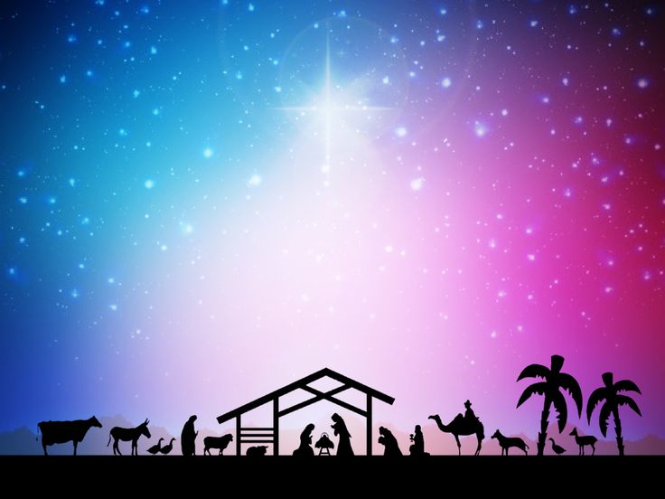
Welcome to
Heritage Country Church

Slide 48
Away In A Manger
Away in a manger
No crib for a bed
The little Lord Jesus
Lay down His sweet head

Slide 49
The stars in the bright sky
Looked down where He lay
The little Lord Jesus
Asleep in the hay

Slide 50
The cattle are lowing
The baby awakes
But little Lord Jesus
No crying He makes

Slide 51
I love Thee, Lord Jesus,
Look down from the sky
And stay by my cradle
‘Til morning is nigh

Slide 52
Be near me, Lord Jesus,
I ask Thee to stay
Close by me forever
And love me, I pray

Slide 53
Bless all the dear children
In Thy tender care
And fit us for heaven
To live with Thee there

Slide 54
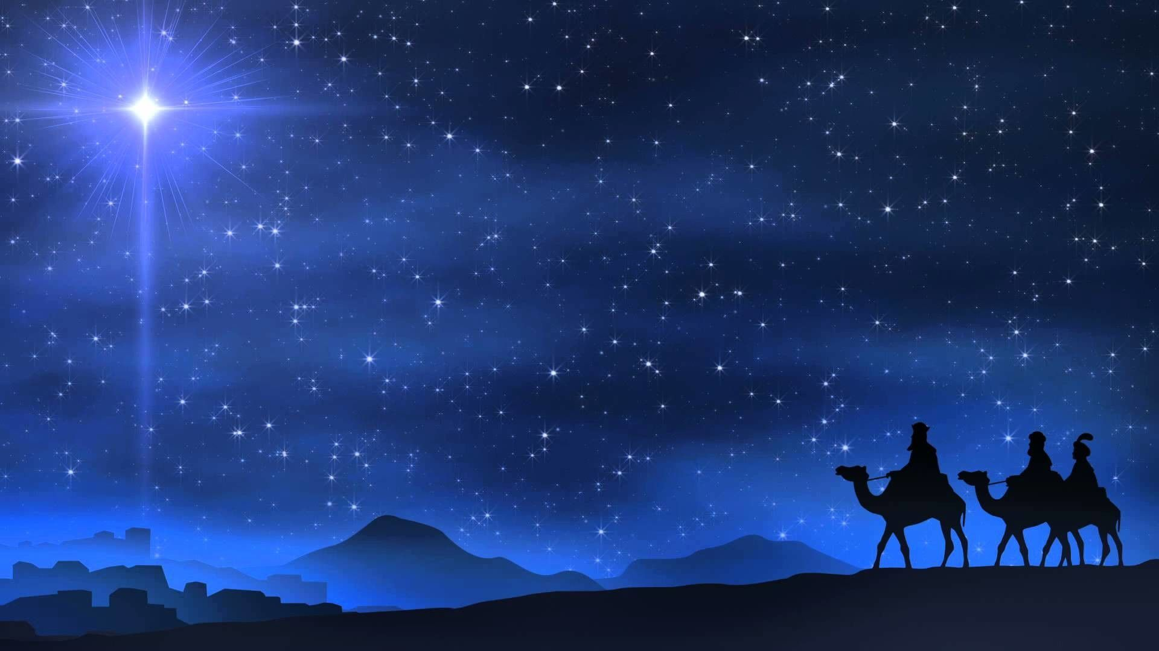
Welcome to
Heritage Country Church

Slide 55
A Hallelujah Christmas
I’ve heard about this baby boy
Who’s come to Earth to bring us joy
And I just want to sing this song
To you

Slide 56
It goes like this, the fourth, the fifth
The minor fall, the major lift
With every breath I’m singing
Hallelujah

Slide 57
Hallelujah,
Hallelujah,
Hallelujah,
Hallelu-u-u-u-jah

Slide 58
A couple came to Bethlehem
Expecting child,
They searched the inn
To find a place
For You were coming soon

Slide 59
There was no room for them to stay
So in a manger filled with hay
God’s only Son was born
Oh, Hallelujah

Slide 60
Hallelujah,
Hallelujah,
Hallelujah,
Hallelu-u-u-u-jah

Slide 61
The shepherds left
Their flocks by night
To see this baby wrapped in light
A host of angels led them all to You

Slide 62
It was just as the angels said
You’ll find Him in a manger bed
Immanuel and Savior, Hallelujah

Slide 63
Hallelujah,
Hallelujah,
Hallelujah,
Hallelu-u-u-u-jah

Slide 64
A star shone bright up in the east
To Bethlehem, the wise men three
Came many miles
And journeyed long for you

Slide 65
And to the place at which You were
Their frankincense
And gold and myrrh
They gave to You and cried out,
Hallelujah

Slide 66
Hallelujah,
Hallelujah,
Hallelujah,
Hallelu-u-u-u-jah

Slide 67
I know You came to rescue me
This baby boy would grow to be
A man and one day die
For me and you

Slide 68
My sins would drive the nails in You
That rugged cross was my cross, too
Still every breath You drew was
Hallelujah

Slide 69
Hallelujah,
Hallelujah,
Hallelujah,
Hallelu-u-u-u-jah

Slide 70
Today’s Scripture
Where’s The Baby
¹ In those days the Philistines gathered their forces for war, to fight against Israel. And Achish said to David, “Understand that you and your men are to go out with me in the army.” ² David said to Achish, “Very well, you shall know what your servant can do.” And Achish said to David, “Very well, I will make you my bodyguard for life.”
1 Samuel 28:1-2
Luke 2:1-7
Matthew 2:1-6

Slide 71
Luke 2:1-2
¹ In those days a decree went out from Caesar Augustus that all the world should be registered. ² This was the first registration when Quirinius was governor of Syria.

Slide 72
Luke 2:3-4
³ And all went to be registered, each to his own town. ⁴ And Joseph also went up from Galilee, from the town of Nazareth, to Judea, to the city of David, which is called Bethlehem, because he was of the house and lineage of David,

Slide 73
Luke 2:5-6
⁵ to be registered with Mary, his betrothed, who was with child. ⁶ And while they were there, the time came for her to give birth.

Slide 74
Luke 2:7
⁷ And she gave birth to her firstborn son and wrapped him in swaddling cloths and laid him in a manger, because there was no place for them in the inn.

Slide 75
Matthew 2:1
¹ Now after Jesus was born in Bethlehem of Judea in the days of Herod the king, behold, wise men from the east came to Jerusalem,

Slide 76
Matthew 2:2-3
² saying, “Where is he who has been king of the Jews? For we saw saw his star when it rose and have come to worship him.” ³ When Herod the king heard this, he was troubled, and all Jerusalem with him;

Slide 77
Matthew 2:4-5
⁴ and assembling all the chief priests and scribes of the people, he inquired of them where the Christ was to be born. ⁵ They told him, “In Bethlehem of Judea, for so it is written by the prophet:

Slide 78
Matthew 2:6
⁶ “‘And you, O Bethlehem, in the land of Judah, are by no means least among the rulers of Judah; for from you shall come a ruler who will shepherd my people Israel.’”

Slide 79
Welcome to
Heritage Country Church
Welcome to
Heritage Country Church

Slide 80
Mary Did You Know
Mary, did you know that your baby boy
Would someday walk on water
Mary, did you know that your baby boy
Would save our sons and daughters?

Slide 81
Did you know that your baby boy
Has come to make you new?
The child that you’ve delivered
Will soon deliver you

Slide 82
Mary, did you know that your baby boy
Will give sight to a blind man?
Mary, did you know that your baby boy
Would calm the storm with His hand?

Slide 83
Did you know that your baby boy
Has walked where angels trod?
When you kiss your little baby
You kiss the face of God
Oh, Mary, did you know?

Slide 84
The blind will see, the deaf will hear
The dead will live again
The lame will leap, the dumb will speak
The praises of the Lamb

Slide 85
Mary, did you know that your baby boy
Is Lord of all creation?
Mary, did you know that your baby boy
Will one day rule the nations?

Slide 86
Did you know that your baby boy
Was heaven’s perfect Lamb?
This sleeping child you’re holding
Is the great “I Am”?
Oh, Mary, did you know?

