Slide 2
Stroll Over Heaven With You
If I surveyed all the good things
That come to me from above
If I count all the blessings
From the storehouse of love

Slide 3
I’d simply ask for the favor
Of Him beyond mortal king
And I’m sure he would grant it again

Slide 4
I want to stroll over Heaven
With You some glad day
When all our troubles and heartaches
Are vanished away

Slide 5
Then we’ll enjoy the beauty
Where all things are new
I want to stroll over Heaven with You

Slide 6
So many places of beauty
We long to see here below
But time and treasures have kept us
From making plans as know

Slide 7
But come the morning of the rapture
Together we’ll stand anew
While I stroll over Heaven with You

Slide 8
I want to stroll over Heaven
With You some glad day
When all our troubles and heartaches
Are vanished away

Slide 9
Then we’ll enjoy the beauty
Where all things are new
I want to stroll over Heaven with You
I want to stroll over Heaven with You

Slide 11
In the Garden
I come to the garden alone
While the dew is still on the roses
And the voice I hear,
Falling on my ear
The son of God discloses

Slide 12
And He walks with me,
And He talks with me
And He tells me I am His own
And the joy we share
As we tarry there
None other has ever known

Slide 13
I’d stay in the garden with Him
Though the night around me be falling
But He bids me go
Through the voice of woe
His voice to me is calling

Slide 14
And He walks with me,
And He talks with me
And He tells me I am His own
And the joy we share
As we tarry there
None other has ever known

Slide 15
And He walks with me,
And He talks with me
And He tells me I am His own

Slide 16
And the joy we share
As we tarry there
None other has ever known
And the joy we share
As we tarry there
None has ever known

Slide 18
Troublesome Waters
Troublesome waters
Much blacker than night
Are hiding from view
of the harbor’s bright lights

Slide 19
Tossed in the turmoil
Of life’s stormy sea
I cry to my Saviour
Have mercy on me

Slide 20
Then gently I’m feeling
The touch of His hands
Guiding my boat
In safely to land

Slide 21
Leading the way
To Heaven’s bright shore
Troublesome waters
I’m fearing no more

Slide 22
Troublesome waters
Around me do roll
They’re rocking my boat
And racking my soul

Slide 23
Loved ones are drifting
And living in sin
The treacherous whirlpools
Are pulling them in

Slide 24
Then gently I’m feeling
The touch of His hands
Guiding my boat
In safely to land

Slide 25
Leading the way
To Heaven’s bright shore
Troublesome waters
I’m fearing no more

Slide 26
When troublesome waters
Are rolling so high
I’ll lift up my voice
And to Heaven I’ll cry

Slide 27
My Lord I am trusting
Give guidance to me
And steady my boat
On life’s troubled sea

Slide 28
Then gently I’m feeling
The touch of His hands
Guiding my boat
In safely to land

Slide 29
Leading the way
To Heaven’s bright shore
Troublesome waters
I’m fearing no more

Slide 30
1/7: Fundraiser Meeting after the service
1/14: Leadership Meeting after the service
1/21: Chili Cook-Off after the service
1/25-27: CTYRA Rodeo
1/28 Potluck after the service
2/11: Leadership Meeting after the service
2/22-24: CTYRA Rodeo
2/25: Potluck after the service
3/1-2: Church Rodeo
3/16: CTBRA Barrel Racing
3/23: Church Fundraiser @ Tenroc Ranch
UPCOMING DATES

Slide 32
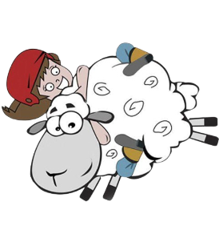
SIGN UPS HAVE STARTED!
TO SIGN UP:
SEE JULIE LUTZ FOR THE FORM
& TO PAY $50 ENTRY FEE
EACH PARTICIPANT GETS A T-SHIRT
WINNER GETS A CUSTOM BELT BUCKLE!

Slide 35
Want to be a judge? Sign up sheet is in the fellowship hall.

Slide 38
Don’t Overlook Salvation
Heaven is a city built by jewels rare
It’s beauty is a splendor yet untold
If you neglect salvation
You’ll never enter in
You’ll never ever walk those streets of gold

Slide 39
So don’t overlook salvation
While living here in sin
Someday it may be too late to pray
Someday when you need Him
He may not let you in
How awful if He should turn you away

Slide 40
Sometimes we get discouraged
While we walk this weary way
But Jesus said He’d every burden bear
So take Him all your troubles
When it seems all hope is gone
Just trust Him when you go to him in prayer

Slide 41
Jesus said be ready
For you know not when the hour
He may come at morning, night or noon
So keep your eyes upon Him
And your soul filled with his power
For you know He’s surely coming soon

Slide 42
So don’t overlook salvation
While living here in sin
Someday it may be too late to pray
Someday when you need Him
He may not let you in
How awful if He should turn you away
How awful if He should turn you away

Slide 44
The Rock That Says My Name
I talk to the people
That lie beneath these stones
Imagining they listen
Makes me feel less alone

Slide 45
I pick up the broken flowers
Sometimes I dig a hole
Welcome in the new ones
Introduce ‘em to the old

Slide 46
I can use a chisel
A polisher the same
I’ll put anything you’d like
To say under a name

Slide 47
I’ll put on my suit
Make sure my tie is straight
Lend a hand to the mourning
Send the loved ones on their way

Slide 48
Well I ain’t afraid of dying
Cause I know where I’ll go
And there I’ll live forever
On the streets made of gold

Slide 49
Till then I’ll keep on workin’
You won’t hear me complain
And every day I’ll tip my hat
To the rock that says my name

Slide 50
Well I hired on out of high school
In 1968
My wife and I picked out a spot
Right up by the game

Slide 51
It ain’t much but every morning
The sun shines on that ground
One of these days when I clock out
That’s where I’m a layin’ down

Slide 52
Well I ain’t afraid of dying
Cause I know where I’ll go
And there I’ll live forever
On the streets made of gold

Slide 53
Till then I’ll keep on workin’
You won’t hear me complain
And every day I’ll tip my hat
To the rock that says my name

Slide 54
Born in Alabama
June 1 9 5 0
Throw the dirt on top of me
Sow the seed and let it grow

Slide 55
Well I ain’t afraid of dying
Cause I know where I’ll go
There I’ll live forever
On the streets made of gold

Slide 56
Till then I’ll keep on workin’
You won’t hear me complain
And every day I’ll tip my hat
To the rock that says my name

Slide 57
Someday when I’m under it
I hope you’ll do the same
Stop by sometime and tip your hat
To the rock that says my name

Slide 59
Are You Washed In The Blood of the Lamb
Have you been to Jesus
For the cleansing power
Are you washed in the blood of the Lamb
Are you fully trusting in His grace this hour
Are you washed in the blood of the Lamb

Slide 60
Are you washed (are you washed)
In the blood (in the blood)
In the soul-cleansing blood of the Lamb
Are your garments spotless
Are they white as snow
Are you washed in the blood of the Lamb

Slide 61
Are you walking daily by the Savior’s side
Are you washed in the blood of the Lamb
Do you rest each moment in the Crucified
Are you washed in the blood of the Lamb

Slide 62
Are you washed (are you washed)
In the blood (in the blood)
In the soul-cleansing blood of the Lamb
Are your garments spotless
Are they white as snow
Are you washed in the blood of the Lamb

Slide 63
When the Bridegroom cometh
Will your robes be white
Pure and white in the blood of the Lamb
Will your soul be ready
For the mansions bright
And be washed in the blood of the Lamb

Slide 64
Are you washed (are you washed)
in the blood (in the blood),
In the soul-cleansing blood of the Lamb
Are your garments spotless
Are they white as snow
Are you washed in the blood of the Lamb

Slide 65
Lay aside the garments
That are stained with sin
And be washed in the blood of the Lamb
There’s a fountain flowing
For the soul unclean
Oh, be washed in the blood of the Lamb

Slide 66
Are you washed (are you washed)
In the blood (in the blood),
In the soul-cleansing blood of the Lamb
Are your garments spotless
Are they white as snow
Are you washed in the blood of the Lamb

Slide 67
Today’s Scripture
Taking Inventory
Ephesians 5:16
Psalms 1:1-3
James 4:14
Matthew 6:34

Slide 68
Ephesians 5:16
¹⁶ making the best use of the time, because the days are evil.

Slide 69
Psalms 1:1
¹ Blessed is the man who walks not in the counsel of the wicked, nor stands in the way of sinners, nor sits in the seat of scoffers;

Slide 70
Psalms 1:2
² but his delight is in the law of the Lord, and on his law he meditates day and night.

Slide 71
Psalms 1:3
³ He is like a tree planted by streams of water that yields its fruit in its season, and its leaf does not wither. In all that he does, he prospers.

Slide 72
James 4:14
¹⁴ yet you do not know what tomorrow will bring. What is your life? For you are a mist that appears for a little time and then vanishes.

Slide 73
Matthew 6:34
³⁴ “Therefore do not be anxious about tomorrow, for tomorrow will be anxious for itself. Sufficient for the day is its own trouble.

Slide 75
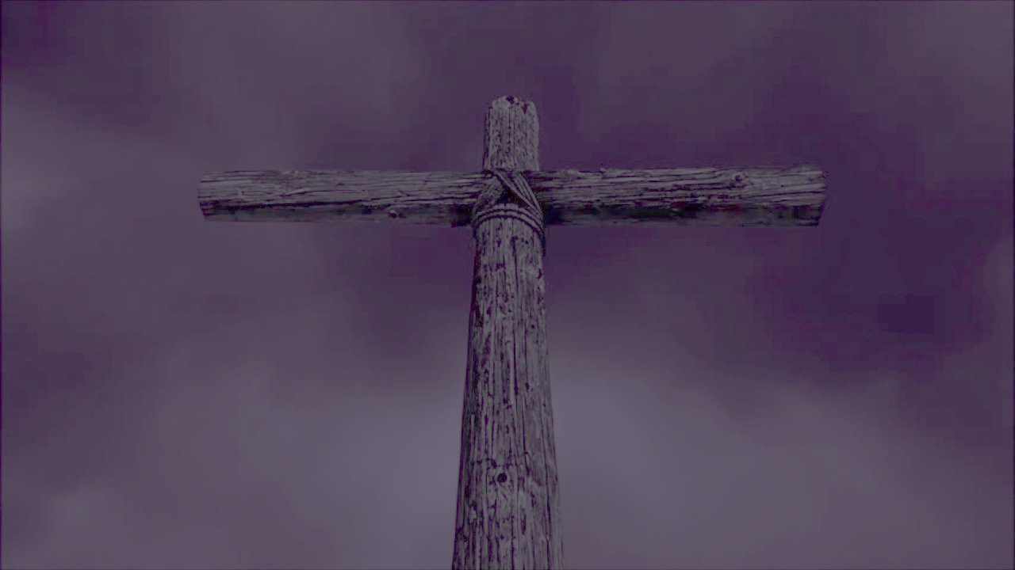
Old Rugged Cross
On a hill far away
Stood an old rugged cross
The emblem of suffering and shame
And I love that old cross
Where the dearest and best
For a world of lost sinners was slain

Slide 76
So, I’ll cherish the old rugged cross
‘Til my trophies at last I lay down
I will cling to the old rugged cross
And exchange it someday for a crown

Slide 77
To that old rugged cross
I will ever be true
It’s shame and reproach gladly bare
Then He’ll call me someday
To my home far away
Where His glory forever I’ll share

Slide 78
And I’ll cherish the old rugged cross
‘Til my trophies at last I lay down
I will cling to the old rugged cross
And exchange it someday for a crown

Slide 79
I will cling to the old rugged cross
And exchange it someday for a crown

